Slide 1


Citi Bike Data Science In New York City Minjae Lee 12/29/2020

Slide 2

Citi Bike Operation
Bike/Scooter sharing is a new p2p consumer business model
Dockstation version in US
12000 citibikes, more than 750 dock stations in NYC
Operated by motivate, gains monopoly to operate shared-bikes in NYC
1. Individual → Subscriber, Customer
2. Corporate

Slide 3
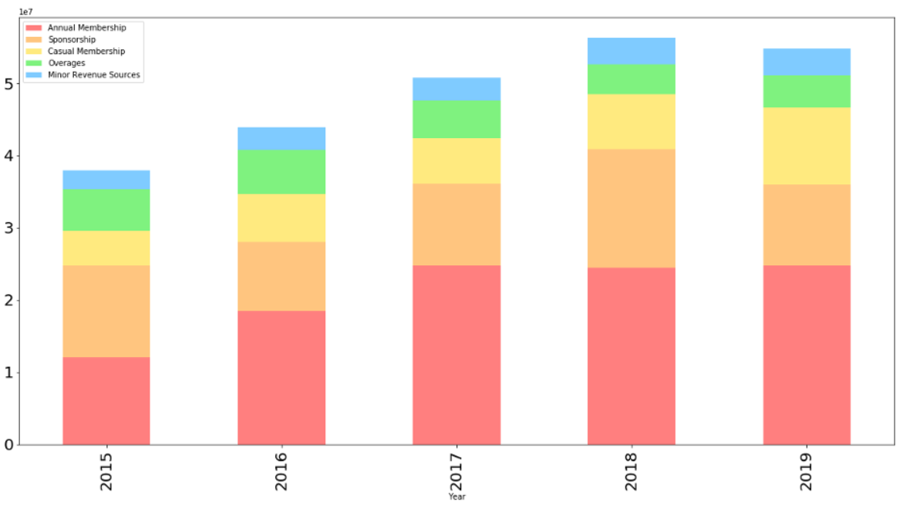
Purpose
The growth of Citi Bike is stagnant due to many sharing competitors. To find out which factors are most important and affect the increase in Subscribers, the most important factor for business growth, and to provide alternatives.

Slide 4
Data
Citi Bike Monthly Trip Data
- Trip data including trip duration, Bike ID,
start and end time, start and end locations,
user type, gender, age
- 5% of each month data
Period of Data
- January 2019 ~ December 2019
Data
- 1,027,583 data and 15 features

Slide 5
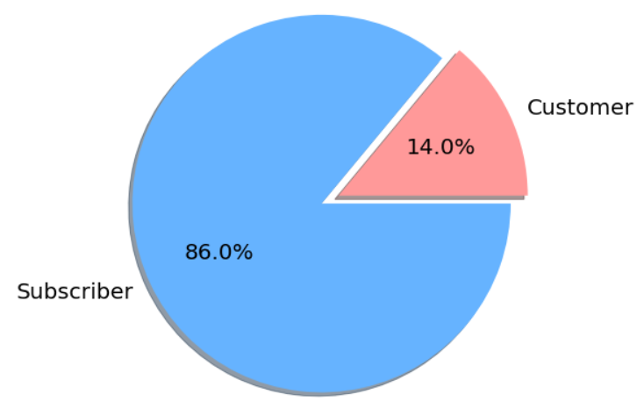
User Type Distribution

Slide 6
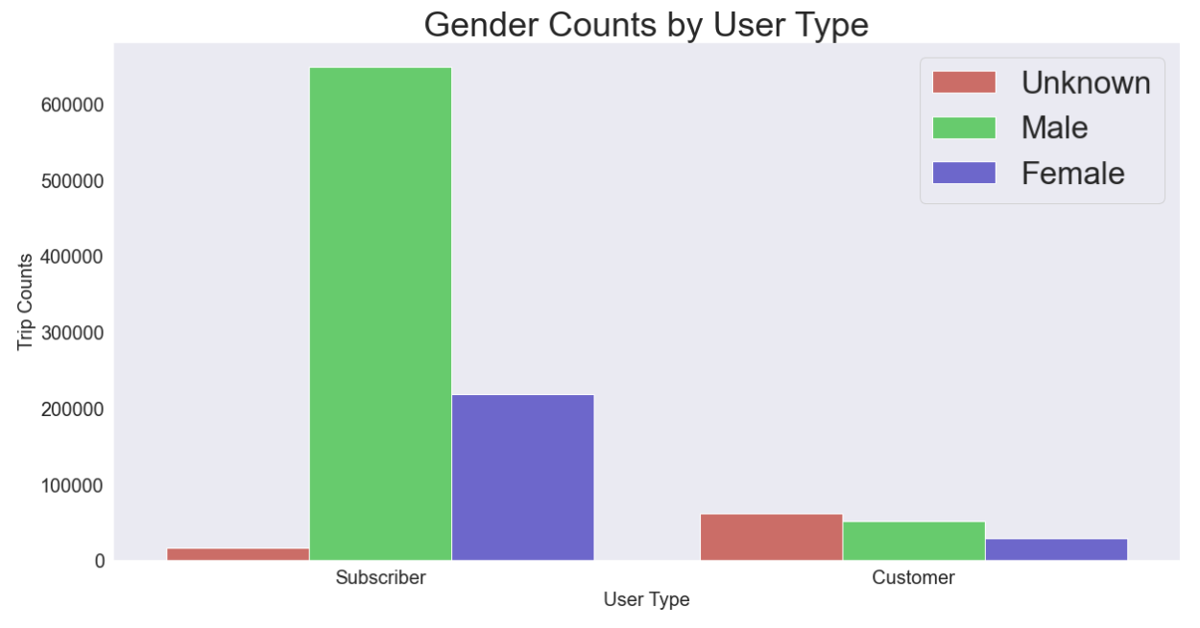
Gender Counts by
User Type
Customer is almost the same, but in Subscribers,
Male is about three times more than Female.

Slide 7
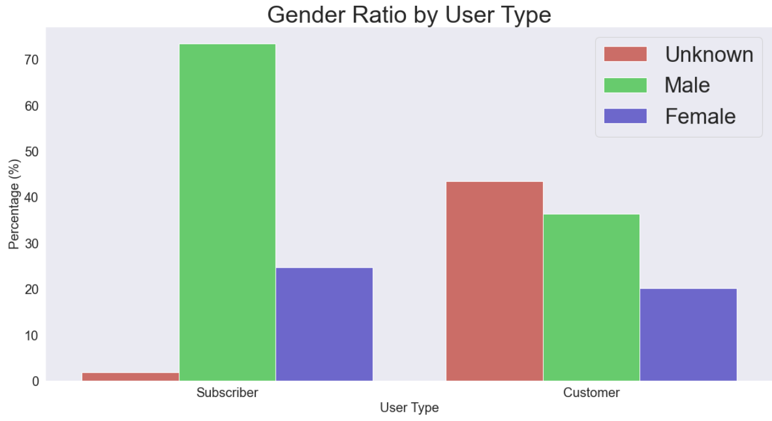
Gender Ratio by
User Type

Slide 8
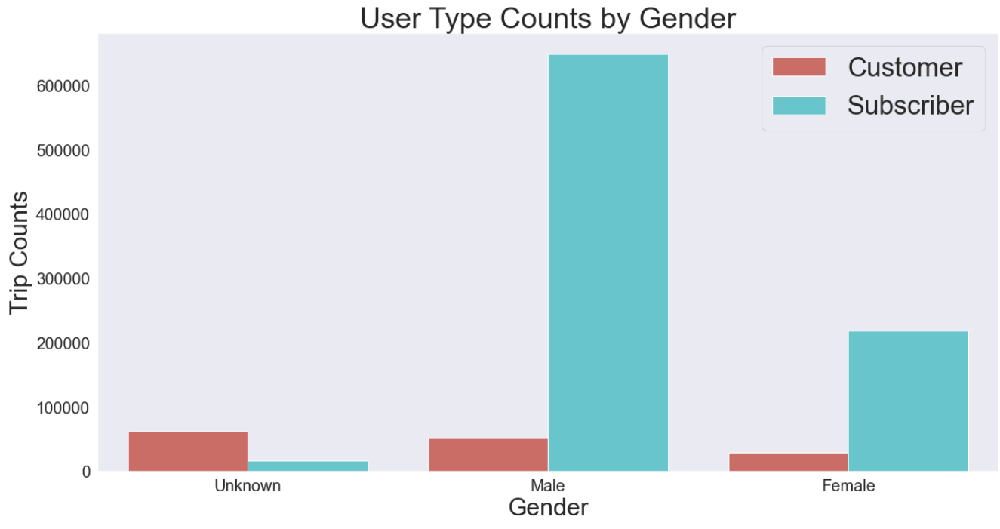
User Type Counts by
User Type
Male Subscribers account for 60% of the total, overwhelmingly. We'll have to target Male Subscribers and create a business plan.

Slide 9
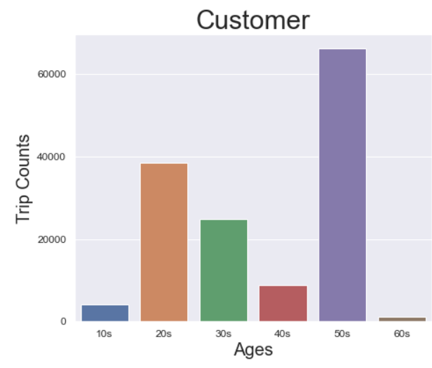
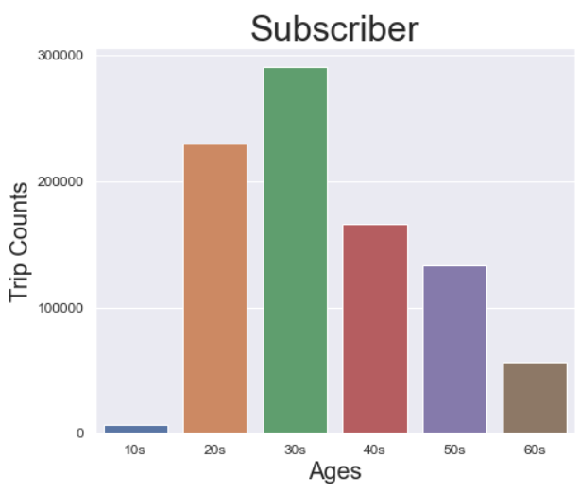
Age Distribution by
User Type

Slide 10
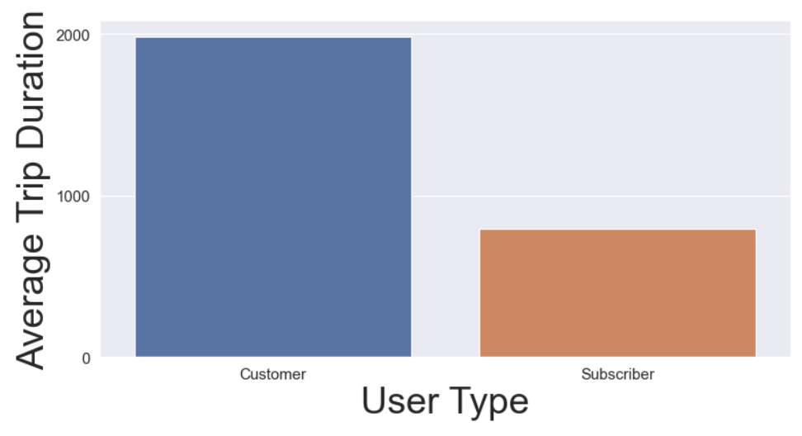
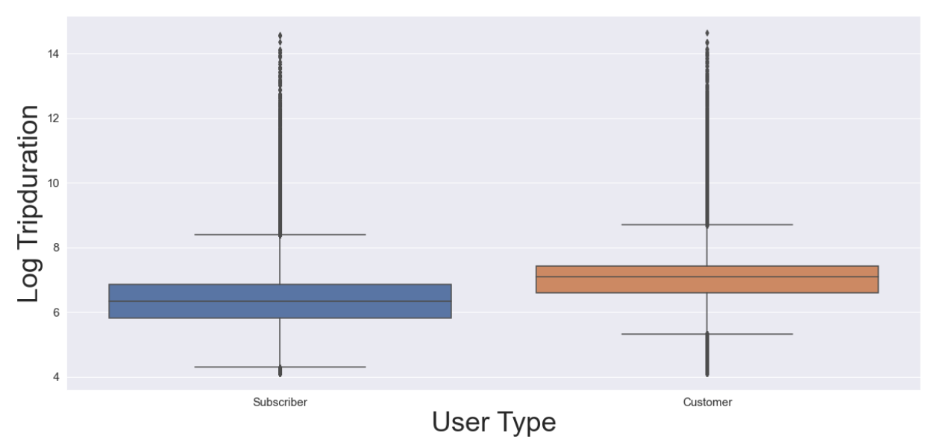
Trip Duration by
User Type

Slide 11
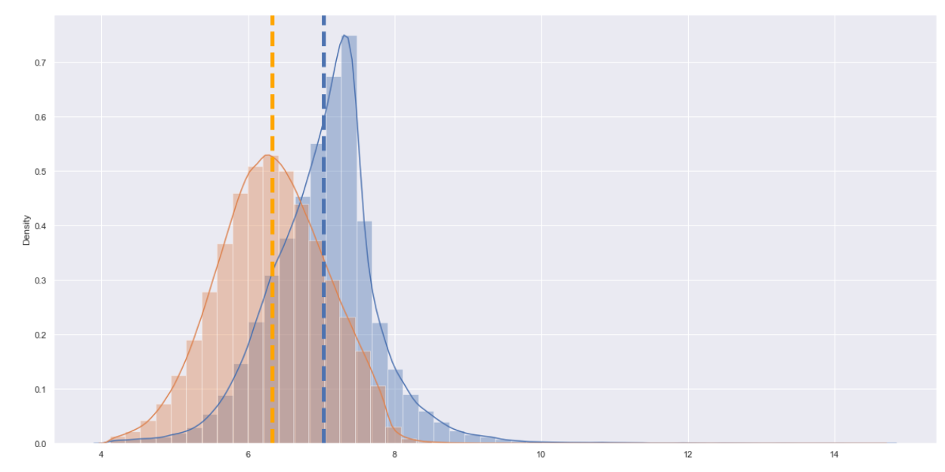

Trip Duration by
User Type

Slide 12
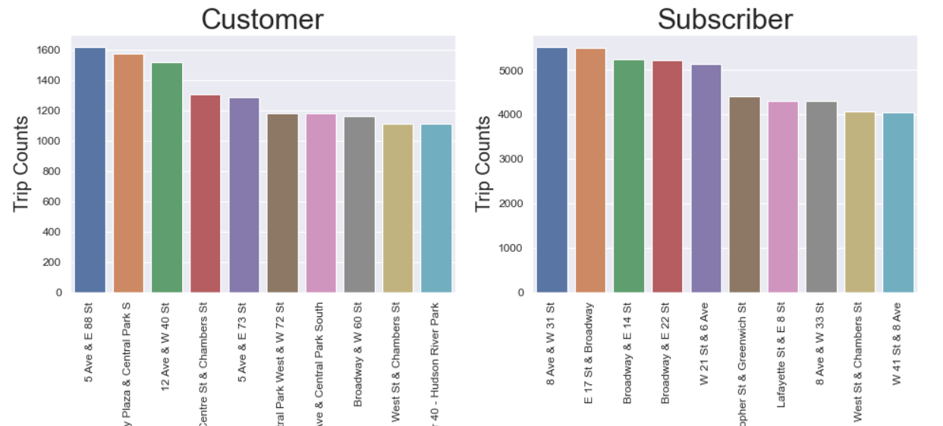
Most Popular Start Stations by User Type

Slide 13
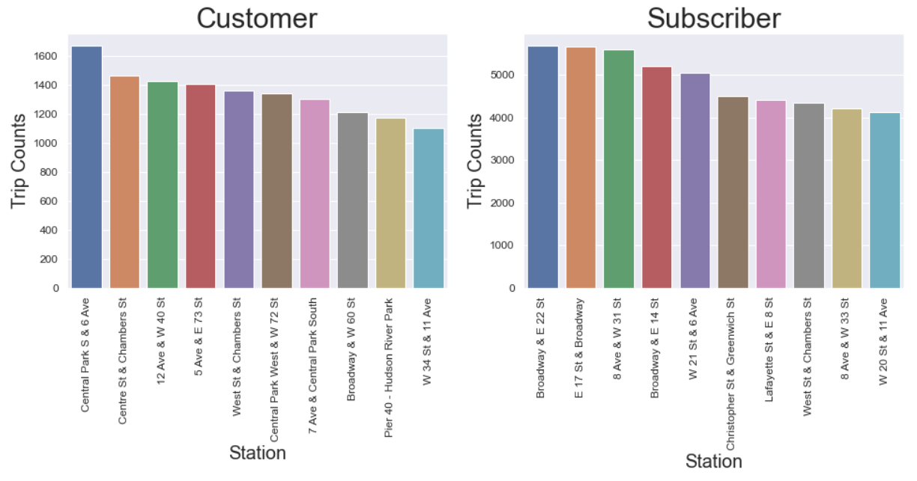
Most Popular Start Stations by User Type

Slide 14
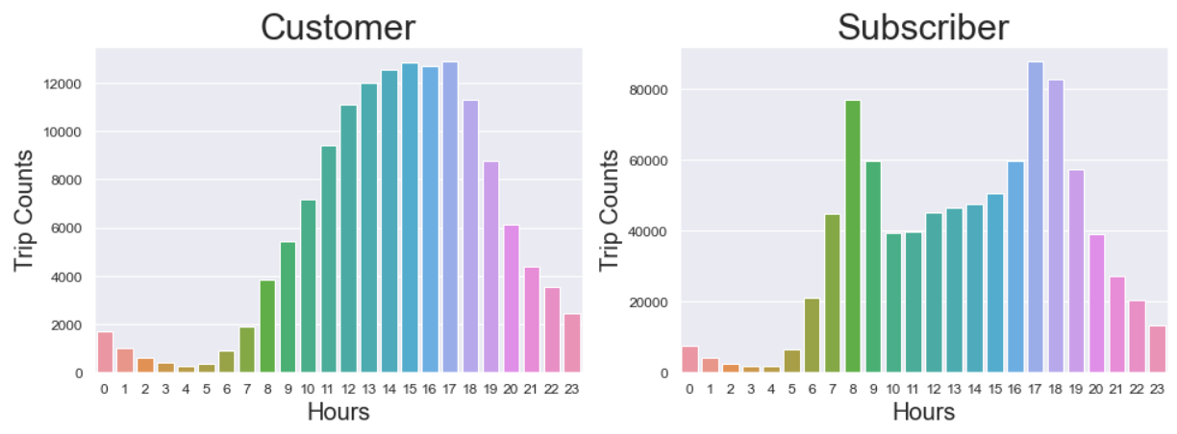
Most Popular Hours by User Type
Customer is mostly distributed during the day when people are usually active. However, Subscribers are the most frequent during rush hour, 7, 8, 9 AM and 14, 15, 16, and 17 PM.

Slide 15
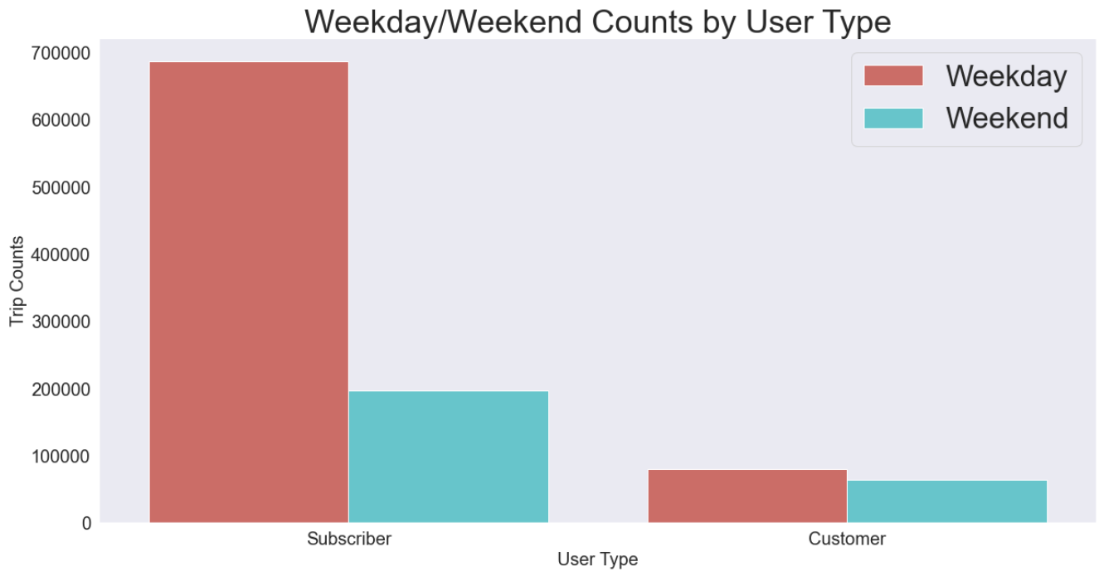
Subscribers in weekday are three time more than weekend.
Customers almost similar weekday and weekend.

Slide 16
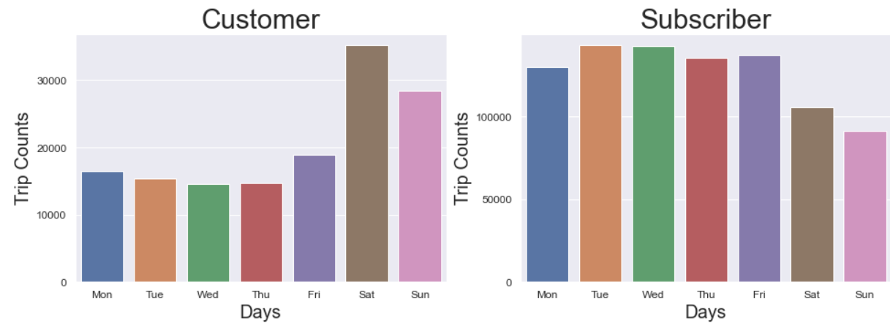
Most Popular Days of by User Type
Subscriber and Customer are the most sharply divided parts. Customer is the weekend, Subscribers are the most distributed during the week. Along with Hour, it can be seen as a feature that best describes the characteristics of the two user types.

Slide 17
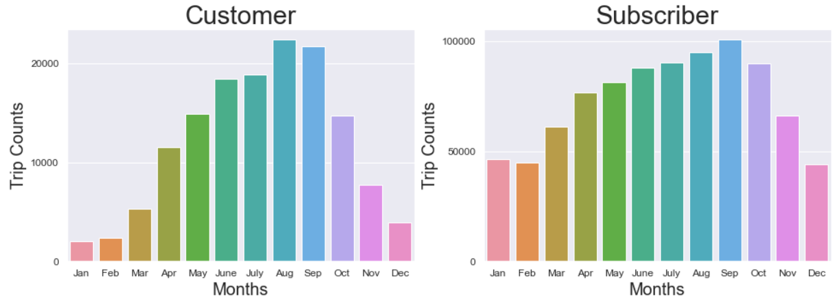
Most Popular Months by User Type

Slide 18
Logistic Regression
-
Machine
Learning

Slide 19
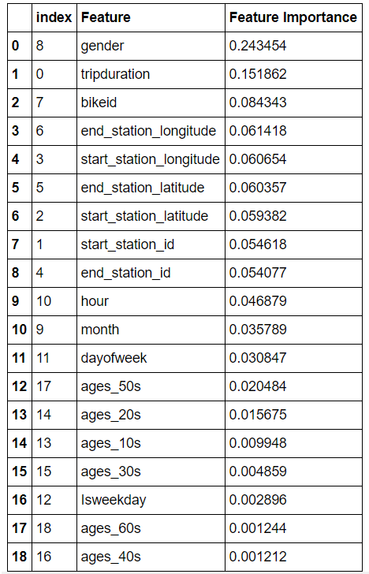
Machine
Learning

Slide 20
User Type Counts by
User Type

Slide 21
Target Variable
• start station checkout counts
Multiple Linear Regression, Ridge
• Model Accuracy: 77.97 % on test data

Slide 22
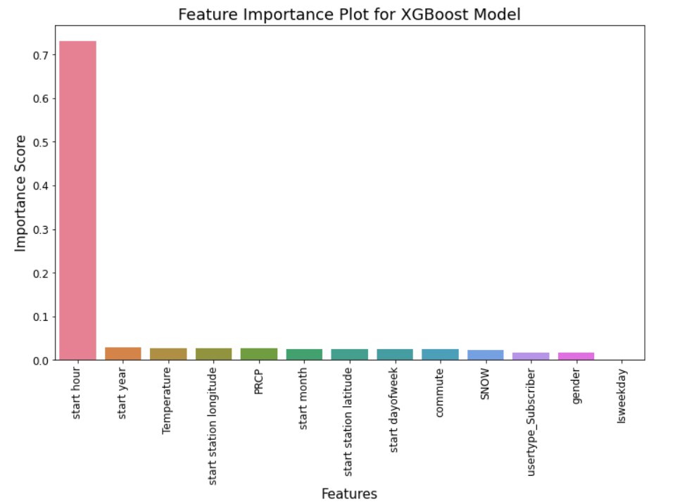
•Feature Importance
Start hour is excessively biased
• Test data 82.4 %

Slide 23
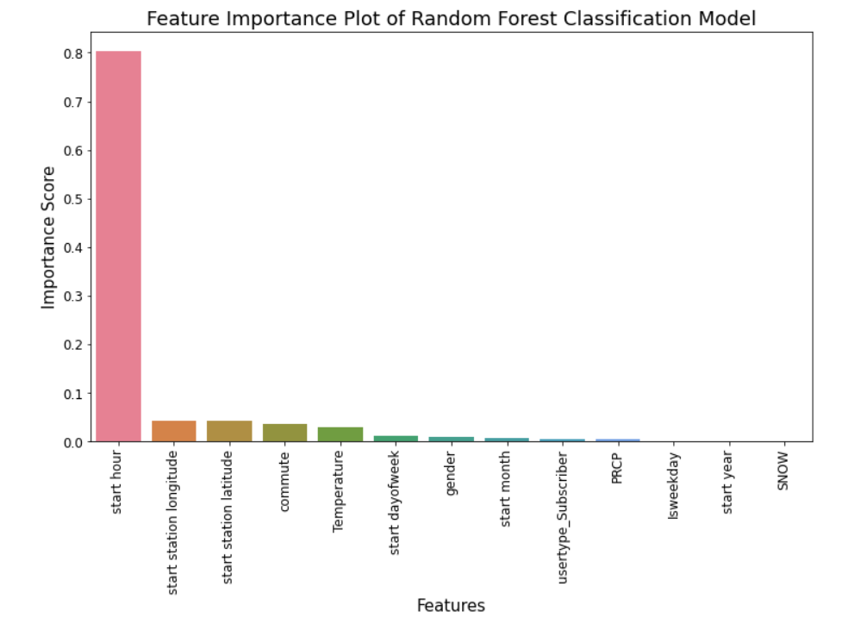
•Feature Importance
Start hour is excessively biased as well
Test data 84.0 %

Slide 24
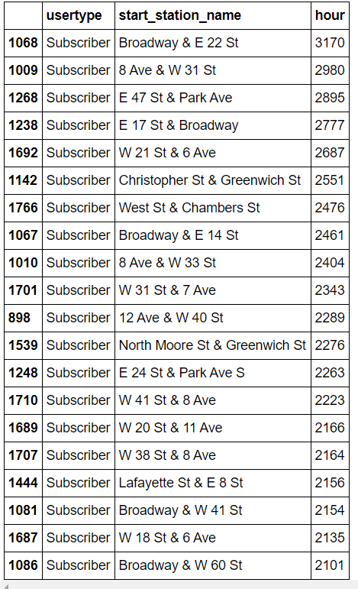
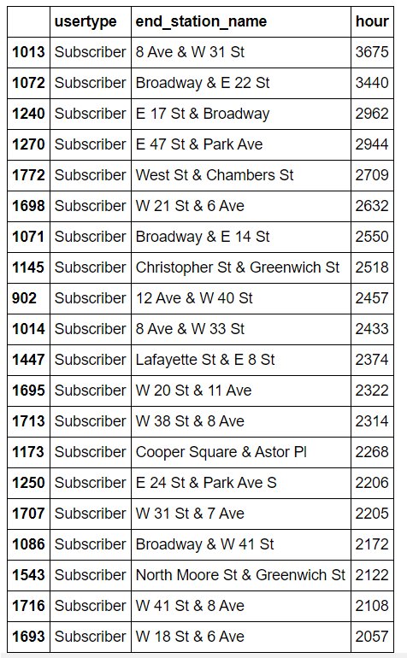
Most Popular Start, End Stations by Subscribers in Rush Hours
[7, 8, 9, 16, 17, 18, 19]

